Slide 1
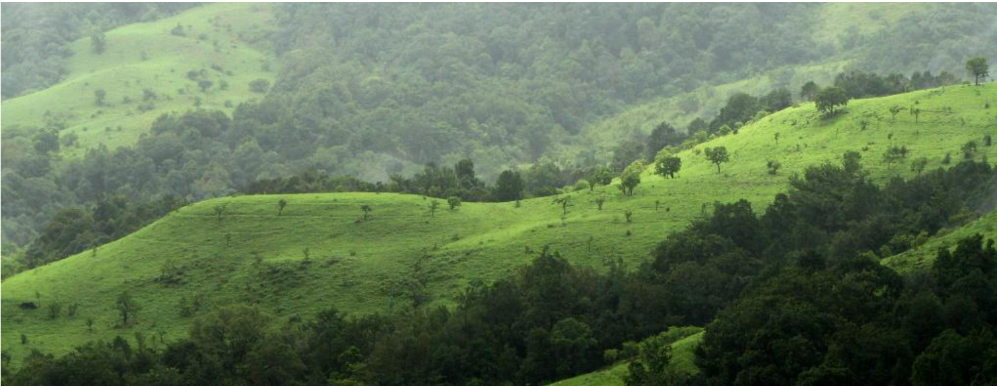
Forest Cover Type Prediction
Final Presentation of 2023 Spring Machine Learning
HaeLee Kim, Nayaeun Kwon, Upmanyu Singh

Slide 2
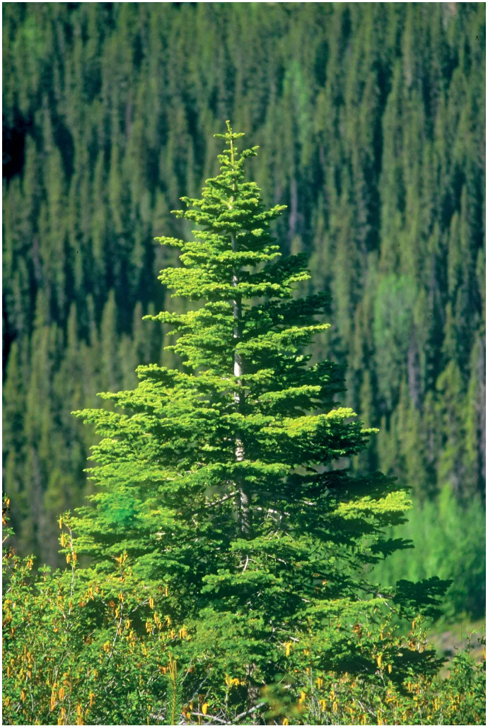
Introduction
o The study area includes four wilderness areas located in the Roosevelt National Forest of northern Colorado.
o Each observation is a 30m x 30m patch.
o Our project will predict an integer classification for the forest cover type (7 types).
1 - Spruce/Fir 2 - Lodgepole Pine 3 - Ponderosa Pine 4 - Cottonwood/Willow 5 - Aspen 6 - Douglas-fir 7 - Krummholz
Forest Cover Type 1 - Spruce/Fir

Slide 3
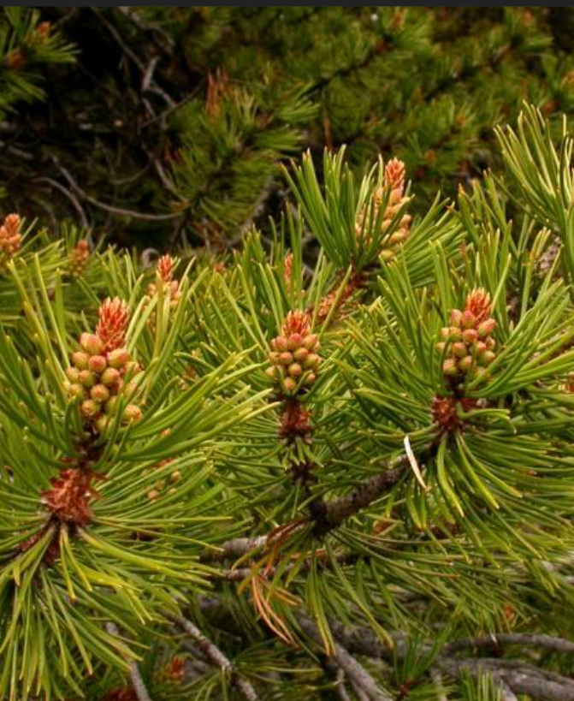
Dataset Description
Number of Instances : 15120 observations
Number of Features : 13 features
Types of Features : integer
Data Source URL: Forest Cover Type Prediction | Kaggle
Forest Cover Type 2 - Lodgepole Pine

Slide 4
The Implemented Features
Elevation - Elevation in meters
Aspect - Aspect in degrees azimuth
Slope - Slope in degrees
Horizontal_Distance_To_Hydrology - Horz Dist to nearest surface water features
Vertical_Distance_To_Hydrology - Vert Dist to nearest surface water features
Horizontal_Distance_To_Roadways - Horz Dist to nearest roadway
Hillshade_9am (0 to 255 index) - Hillshade index at 9am, summer solstice
Hillshade_Noon (0 to 255 index) - Hillshade index at noon, summer solstice
Hillshade_3pm (0 to 255 index) - Hillshade index at 3pm, summer solstice
Horizontal_Distance_To_Fire_Points - Horz Dist to nearest wildfire ignition points
Wilderness_Area (4 binary columns, 0 = absence or 1 = presence) - Wilderness area designation
The wilderness areas are:
1 - Rawah Wilderness Area 2 - Neota Wilderness Area 3 - Comanche Peak Wilderness Area 4 - Cache la Poudre Wilderness Area
Soil_Type (40 binary columns, 0 = absence or 1 = presence) - Soil Type designation
The soil types are, for example:
1 - Cathedral family - Rock outcrop complex, extremely stony. 40 - Moran family - Cryorthents - Rock land complex, extremely stony.
Cover_Type (7 types, integers 1 to 7) - Forest Cover Type designation

Slide 5
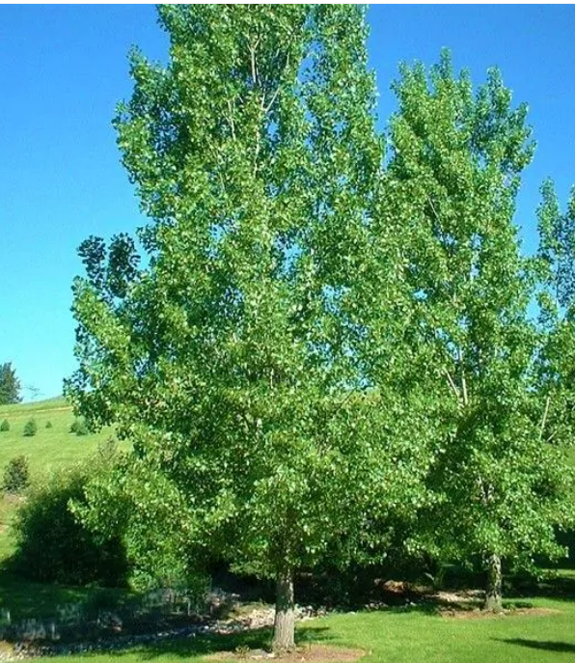
Expected Outcomes
Goal
Predict an integer classification for the forest cover type
Target
Cover_Type (7 types) - Forest Cover Type designation
ML Models
Random Forest, KNN, MLP, Decision Tree
Forest Cover Type 4 - Cottonwood/Willow

Slide 6
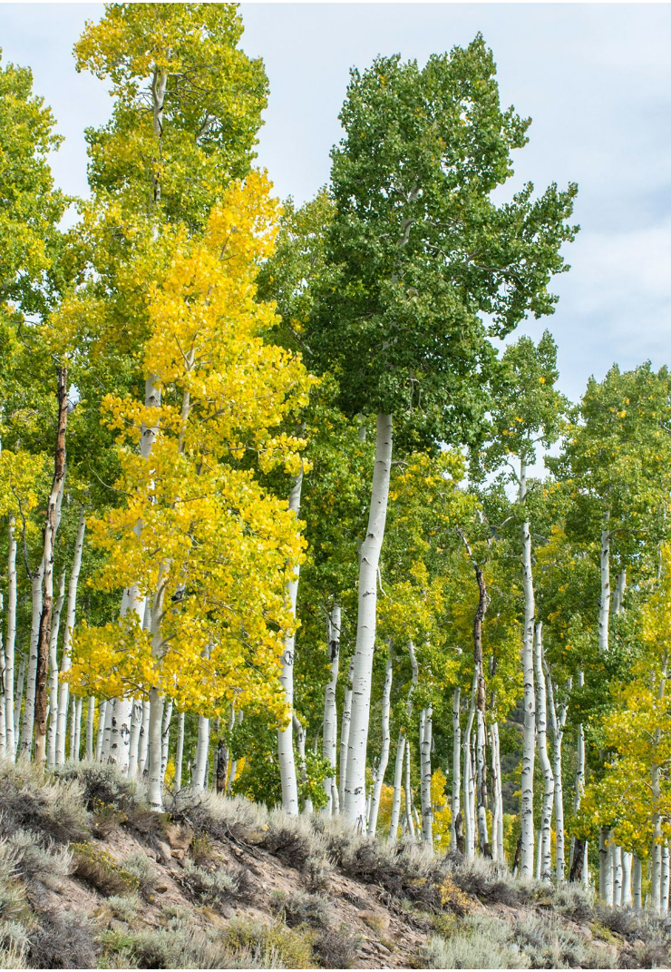
Data Preprocessing
o Split the data - 20% test, 80% train
o No uncommon features
o Handed missing variables - No nulls
o Removed outliers
o Encoded the data - all the categorical variables are already label encoded.
o Scaled the data - standard scaler (from sklearn.preprocessing import StandardScaler)
Forest Cover Type 5 - Aspen

Slide 7
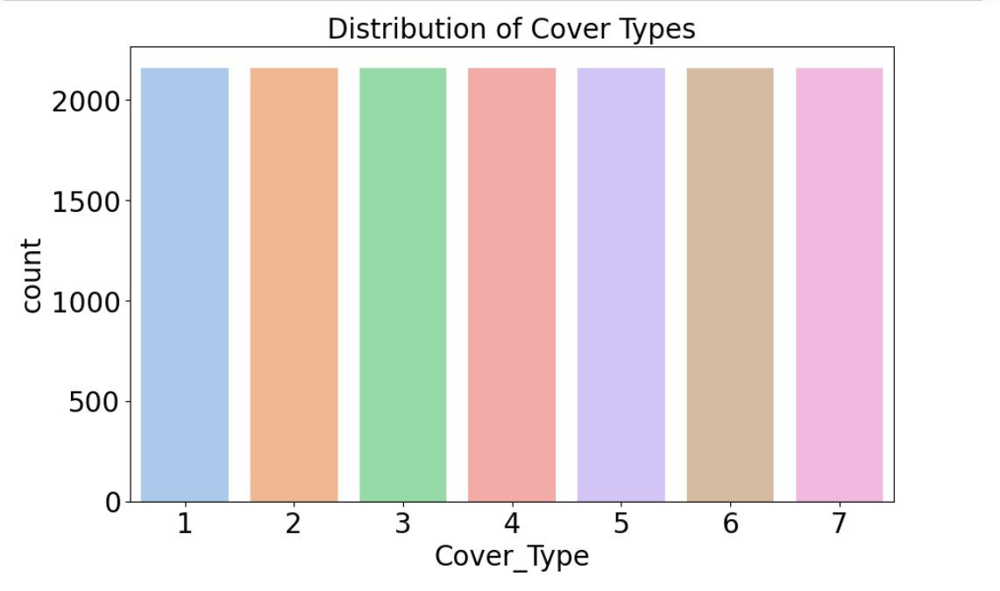
EDA
We have an equal number of data points for all forest cover types in our dataset, which means that there is no imbalance present.

Slide 8
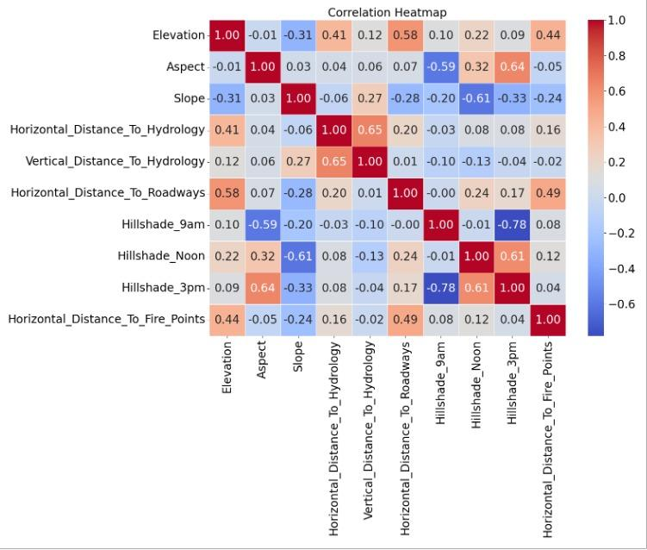
EDA
We created a correlation heatmap to visualize the relationship between all the continuous variables in the dataset.
One key insight we gained from the heatmap was that the elevation column has a significant correlation with all the features related to horizontal distance.
Another important finding was that Hillshade 9am and Hillshade 3pm have a high negative correlation. This makes sense, as the hillshade at 9am and 3pm will be opposite of each other.

Slide 9
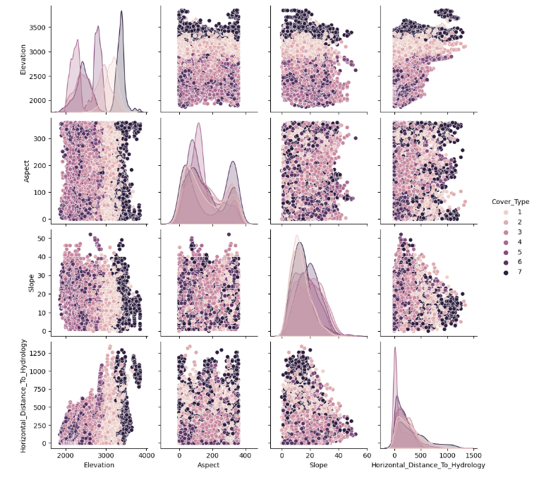
EDA
A pairplot to visualize the relationships between different continuous variables such as elevation, aspect, slope, and various distance measures (e.g. used horizontal distance to hydrology).
Higher elevations were more likely to have forest cover type 7. This was evident in plots comparing elevation to other features, where the highest elevation values consistently corresponded to type 7 forest cover.

Slide 10
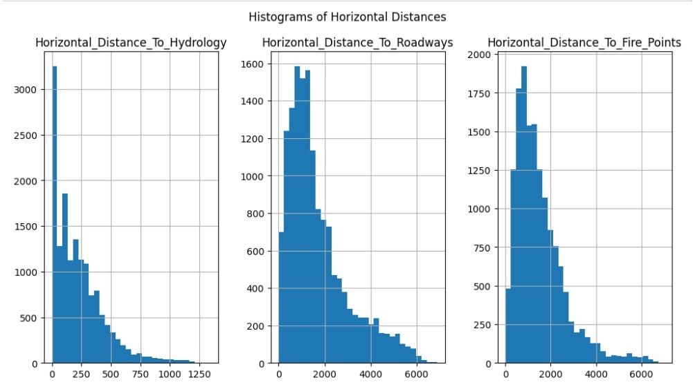
EDA
The distribution of horizontal distance measures (to hydrology, roadways, and fire points) are all right-skewed, indicating that most of the forest cover types are located relatively close to these features.
This suggests that proximity to water and accessibility via roadways may be important factors in determining forest cover type.

Slide 11
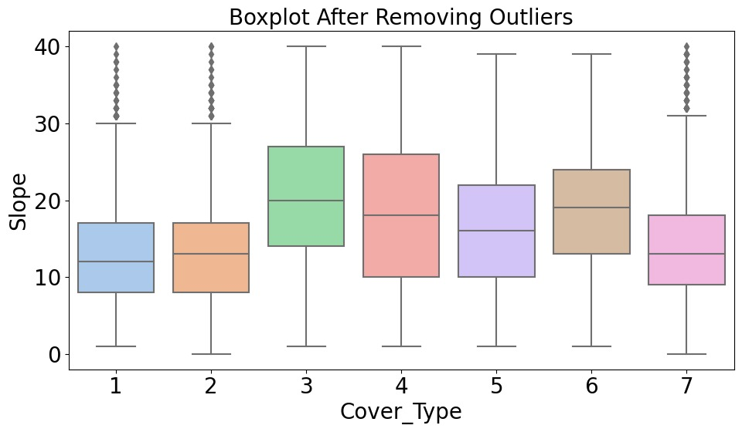
EDA
This box plot shows the distribution of slope among different forest cover types after removing outliers.
Forest cover types 3 and 4 have a higher median slope compared to other cover types.
Forest cover types 1, 2, and 7 have the lowest median slope, although there are a significant number of outliers among them.

Slide 12
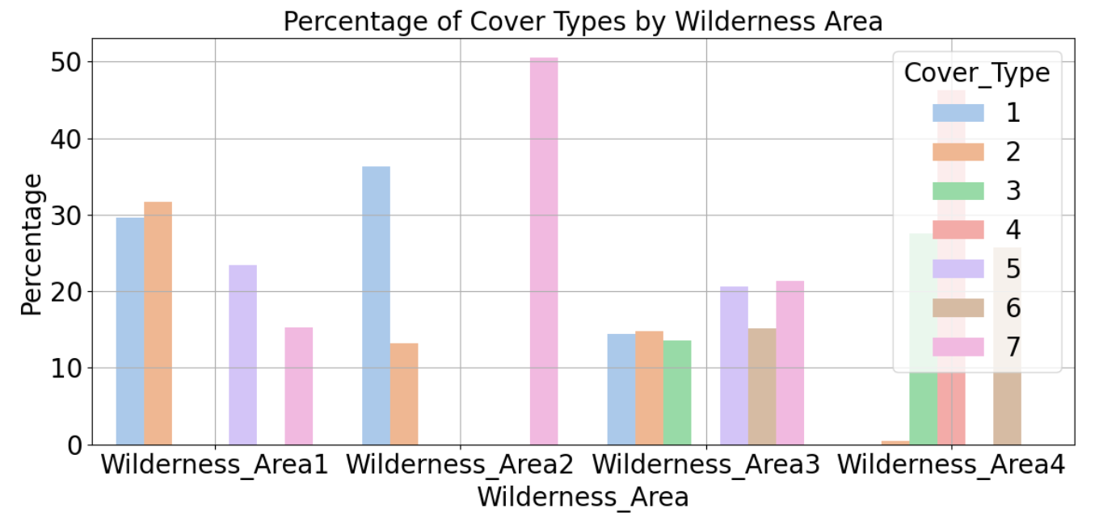
EDA
Percentage of cover types by wilderness area was analyzed.
Wilderness area 2 only had forest cover types 1, 2 and 7.
Wilderness area 4 had the highest percentage of forest cover type 4.

Slide 13
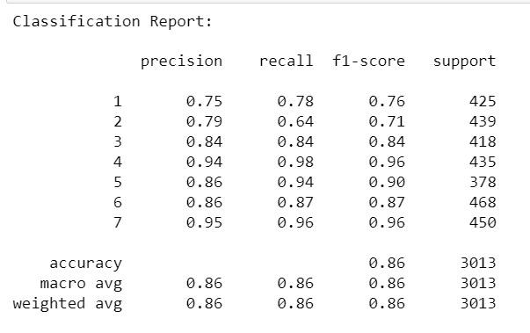
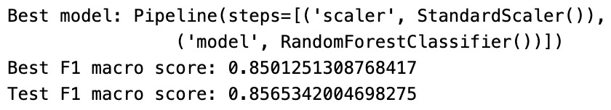
ML Analysis - Best Model: Random Forest Model
We evaluated multiple machine learning models, including Random Forest, KNN, MLP, and Decision Tree.
We found that Random Forest was the best performer with an F1 score score of 0.86.
Therefore, we chose it as our final model for predicting forest cover types.

Slide 14
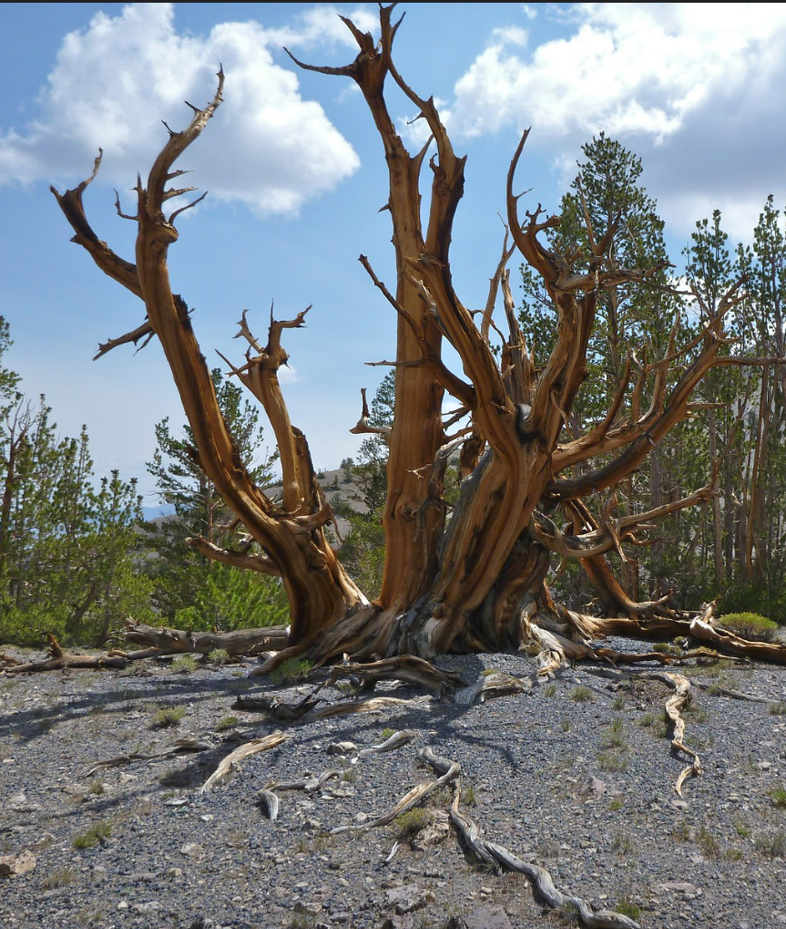
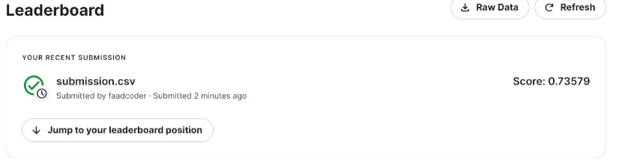
Conclusion
Our project aimed to predict the forest cover type using machine learning models, resulting in the prediction of an integer classification for the forest cover type with 7 types.
Among the machine learning models used, Random Forest achieved the highest level of accuracy in predicting the forest cover type.
Our project achieved a score of 0.73579 in the Kaggle submission, demonstrating the effectiveness of our approach in solving the problem of forest cover type prediction.
Forest Cover Type 7 - Krummholz

Slide 15
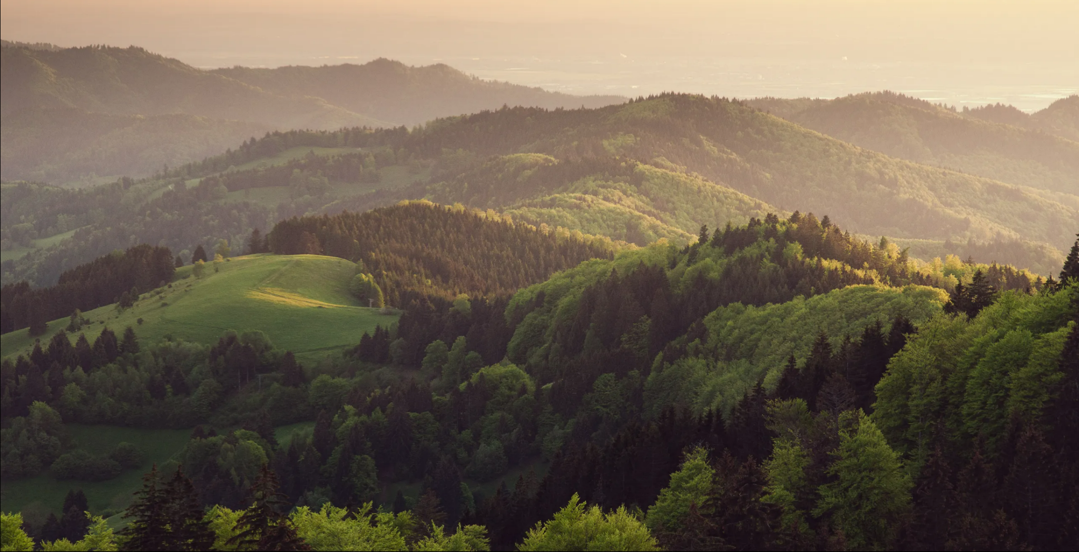
Thank you!

